Slide 1

Automated Grass cutter
Dr: Nora Niazy
Eng: Ahmed Hany

Slide 2
Team members:
Essam Ali Abdo (Team Leader)
Ebrahim Mohamed Hassan
Alaa El-diin Mohamed
Khaled Mohamed Abo hashim

Slide 3

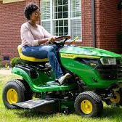
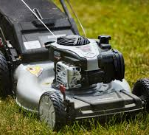
Why do we need an automated grass cutter ?
Grass cutter machine become very popular today. This machine is commonly used to tidy up the garden and to clear the fields from grass or other types of herbs.
As it requires human power to control it and powered by gasoline, we will face the problem of air pollution In addition the energy crisis that hit our world , using the traditional grass cutter will not be efficient anymore.
In our project we will try to over come all this problems by providing an automated grass cutter that’s remotely controlled and powered by electricity to reduce human effort and air pollution.

Slide 4
Project idea:
An automated grass cutter that is powered by solar energy. It handles the grass level and measure soil moisture level for irrigation process.
We use solar panel so there is no need to charge its battery externally.
A mobile application connected through wi-fi is used for controlling the model and all the measurements taken are displayed on the application for the user to see.

Slide 5
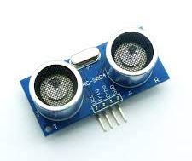
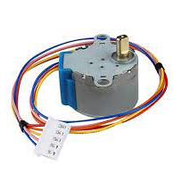
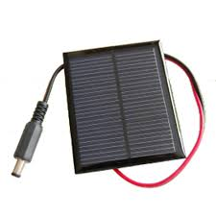
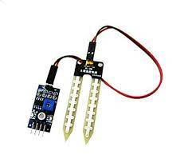
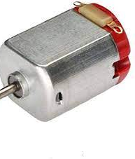
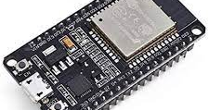
Tools Used:
Mobile application:-
React Native
java - Android Studio
MySQL database
Embedded system:-
programming language : “C ”
Hardware:-
ESP32
soil moisture sensor
dc motor
stepper motor
solar energy plate
ultrasonic sensor
GPS module

Slide 6
PROJECT TIMELINE – GANTT CHART
OCT
NOV
DEC
JAN
FEB
MAR
APR
MAY
Feasibility Study
10 days
15/10/22 – 25/10/22
Analysis
25 days
26/10/22 – 20/11/22
Mobile Design
20 days
21/11/22 – 10/12/22
Mobile Implementation
40 days
11/12/22 – 20/1/23
vehicle Design
30 days
21/1/23 – 10/2/23
Embedded Implementation
90 days
11/2/23 – 11/5/23
Testing
10 days
12/5/23 – 21/5/23
Documentation
225 days
15/10/22 – 21/5/23

Slide 7
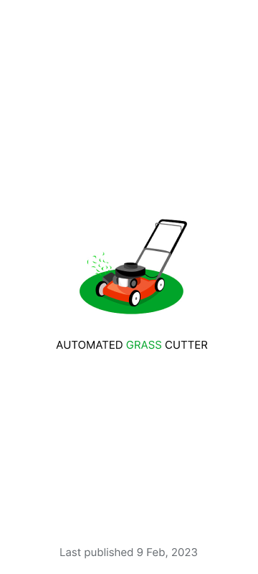
Mobile app screens

Slide 8
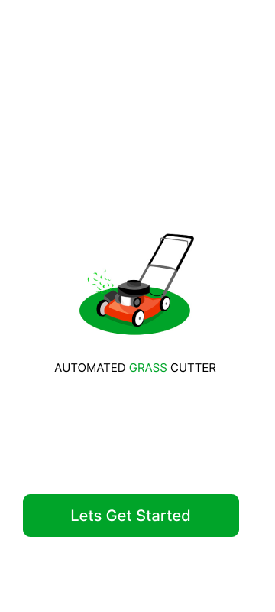
On boarding screens

Slide 9
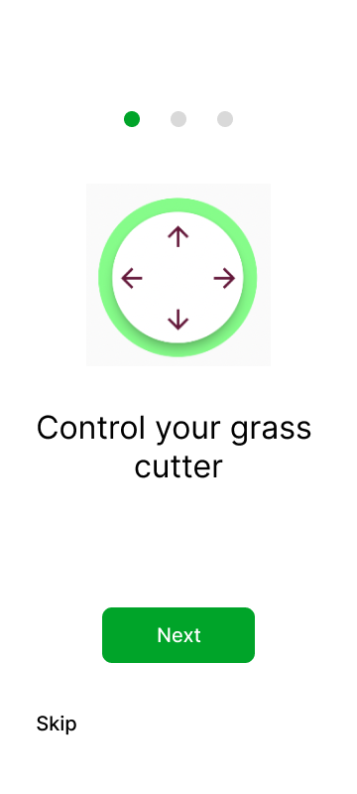

Slide 10
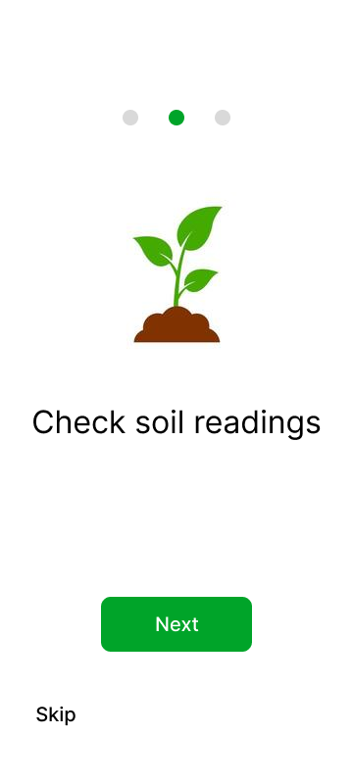

Slide 11


Slide 12
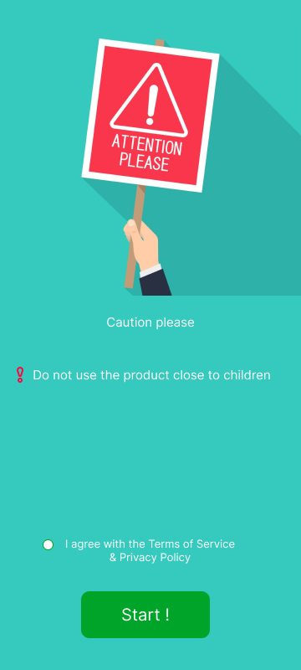

Slide 13
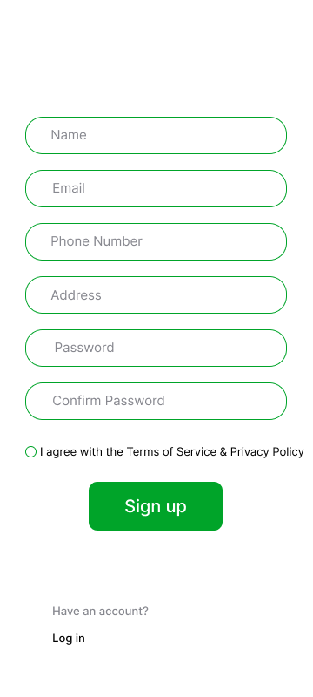
Registration screen

Slide 14
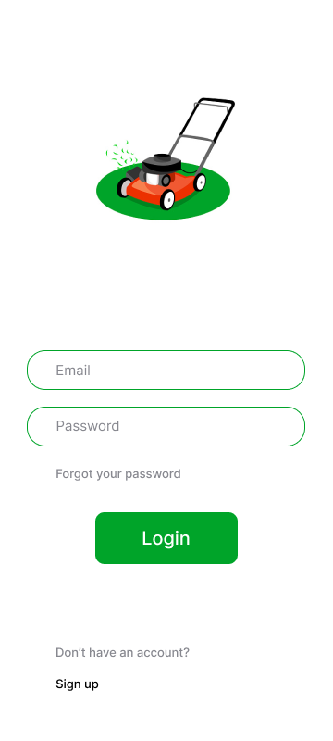
Login screen

Slide 15
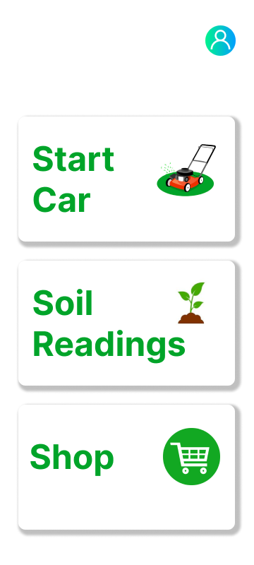
Home screen

Slide 16

Home scroll

Slide 17
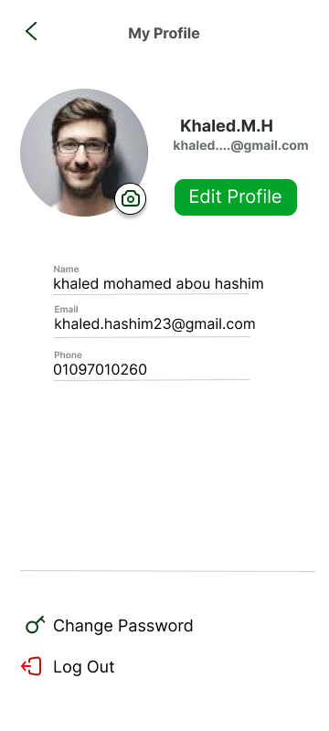
Profile screen

Slide 18
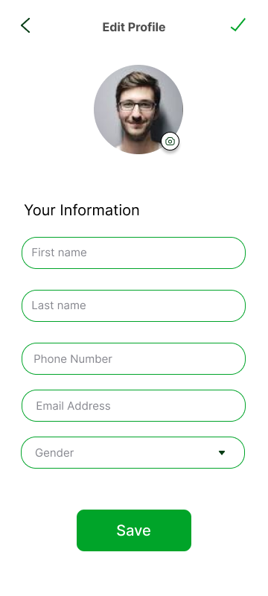
Edit profile screen

Slide 19
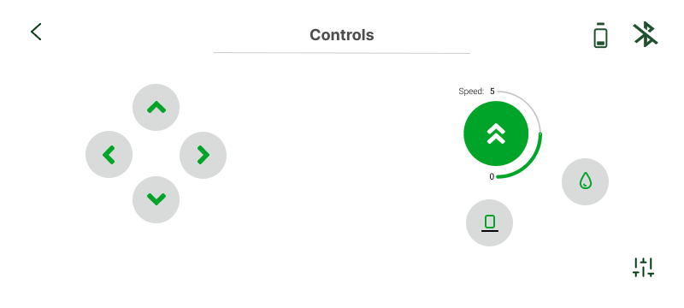
Controls screen

Slide 20

Readings screen

Slide 21
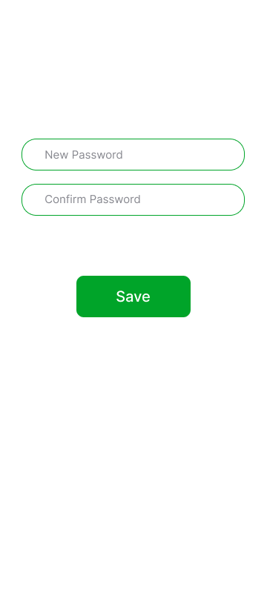
Reset password screen

Slide 22
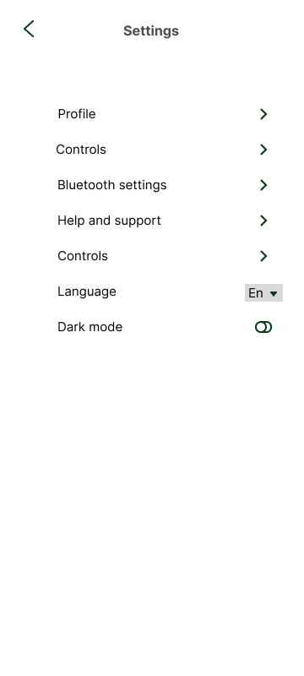
Settings screen

Slide 23
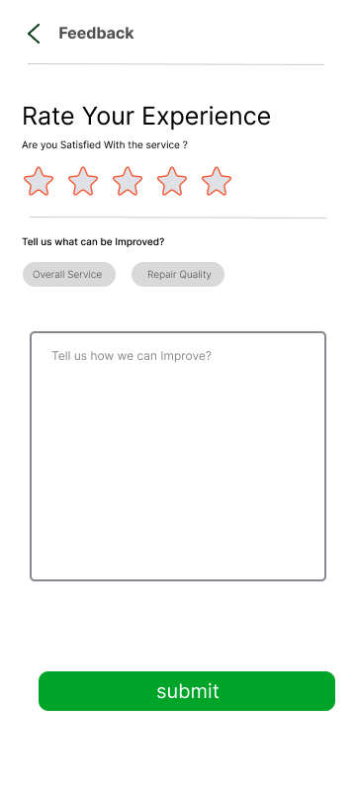
Feedback screen

Slide 24


